Slide 1
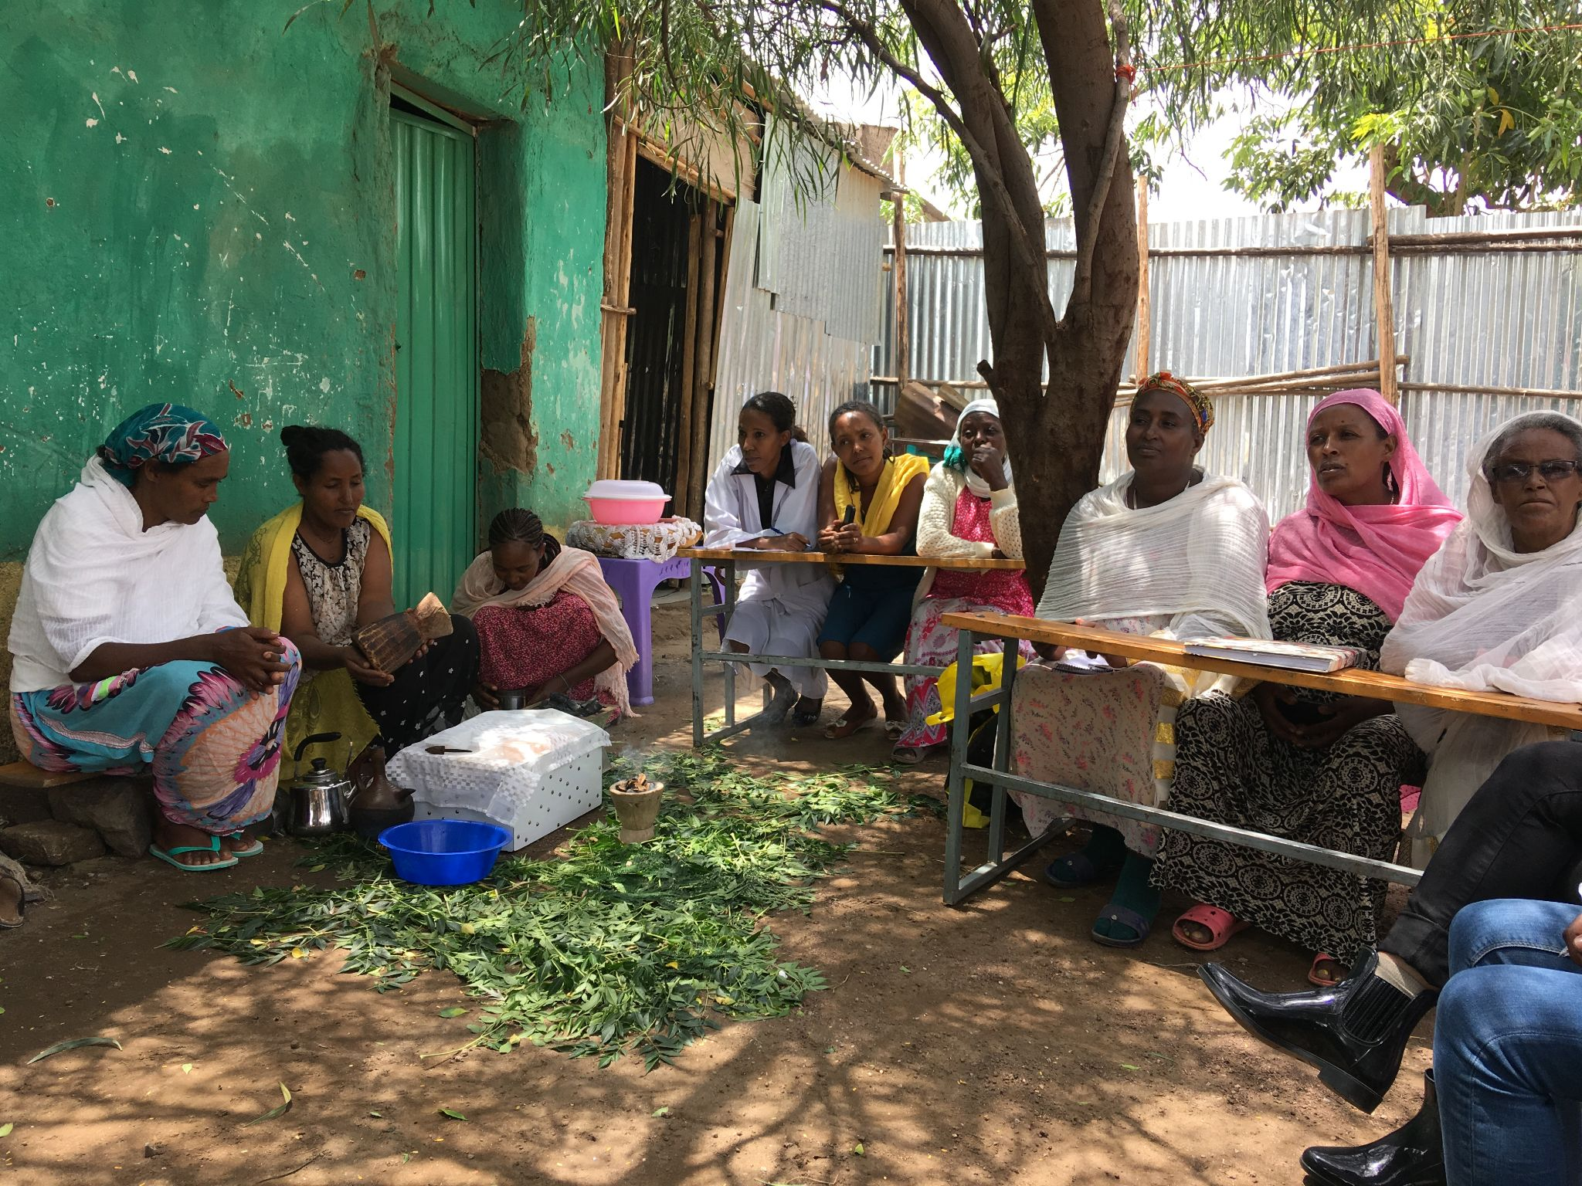
Women’s Business, Empowerment,
and the “Self-Help Approach”
CoSAP and The New School
23 June 2023
Notes:
Attempt to answer this Q.

Slide 2
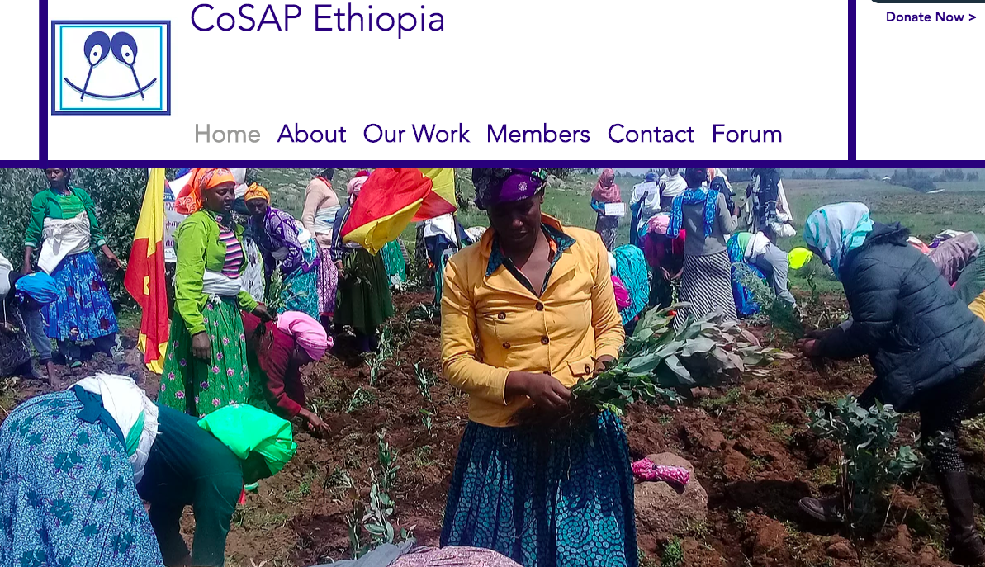

Slide 3
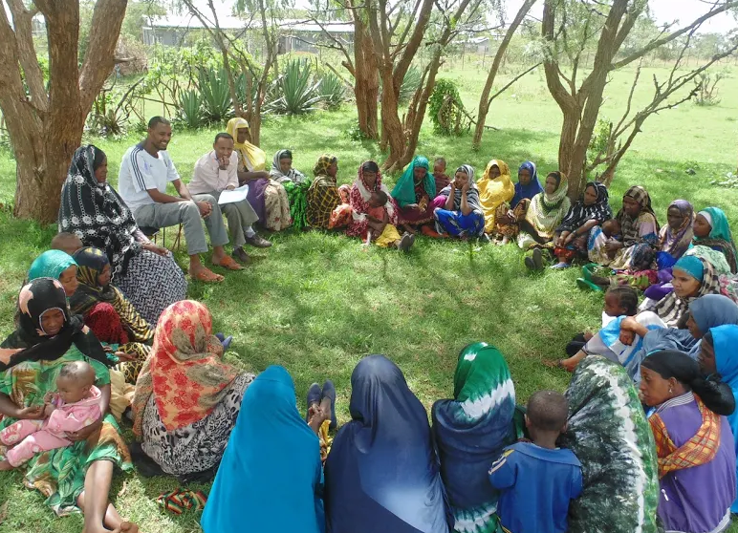
Economic Development - How to break poverty cycle?
Informal economy, under-employment, day and seasonal labor
Notes:
Attempt to answer this Q.

Slide 4
Aid and Economic Development
What is methodology for something so complicated?
Raise income?
Assets? In-kind or cash?
“Empowerment”?
Gendered - Work primarily with women?
Education
Health
All of the above

Slide 5
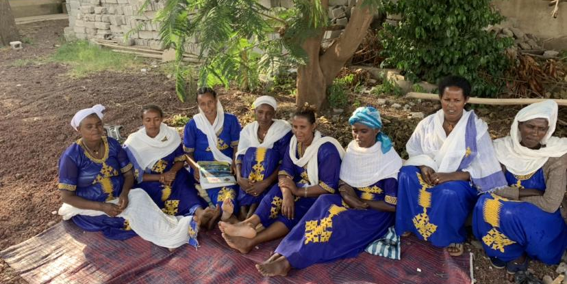
Women’s Self-Help Groups Theory of Change
CoSAP NGO community mobilizers organize a neighborhood of women into a group.
Group gives women opportunity to meet together weekly, through meetings, members become friends and collaborators.

Slide 6
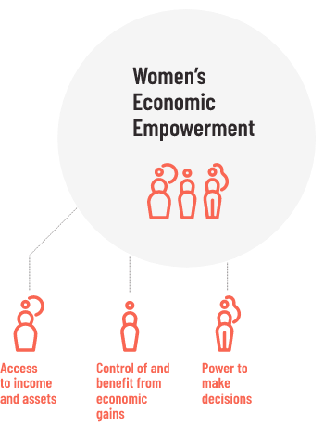
Women’s Economic Empowerment
The ability to:
Make decisions about her own financial well-being.
Controlling financial assets such as investments or property.

Slide 7
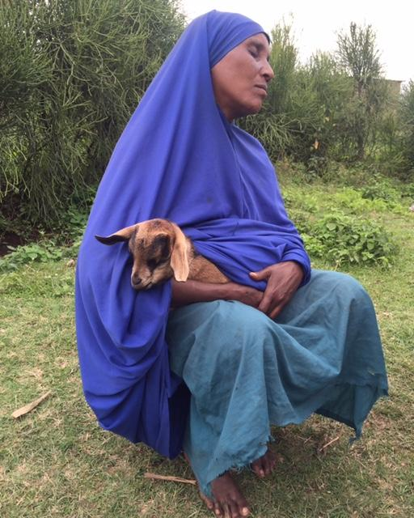
Better Practice: Savings
Buffer against economic shock that is almost inevitable

Slide 8
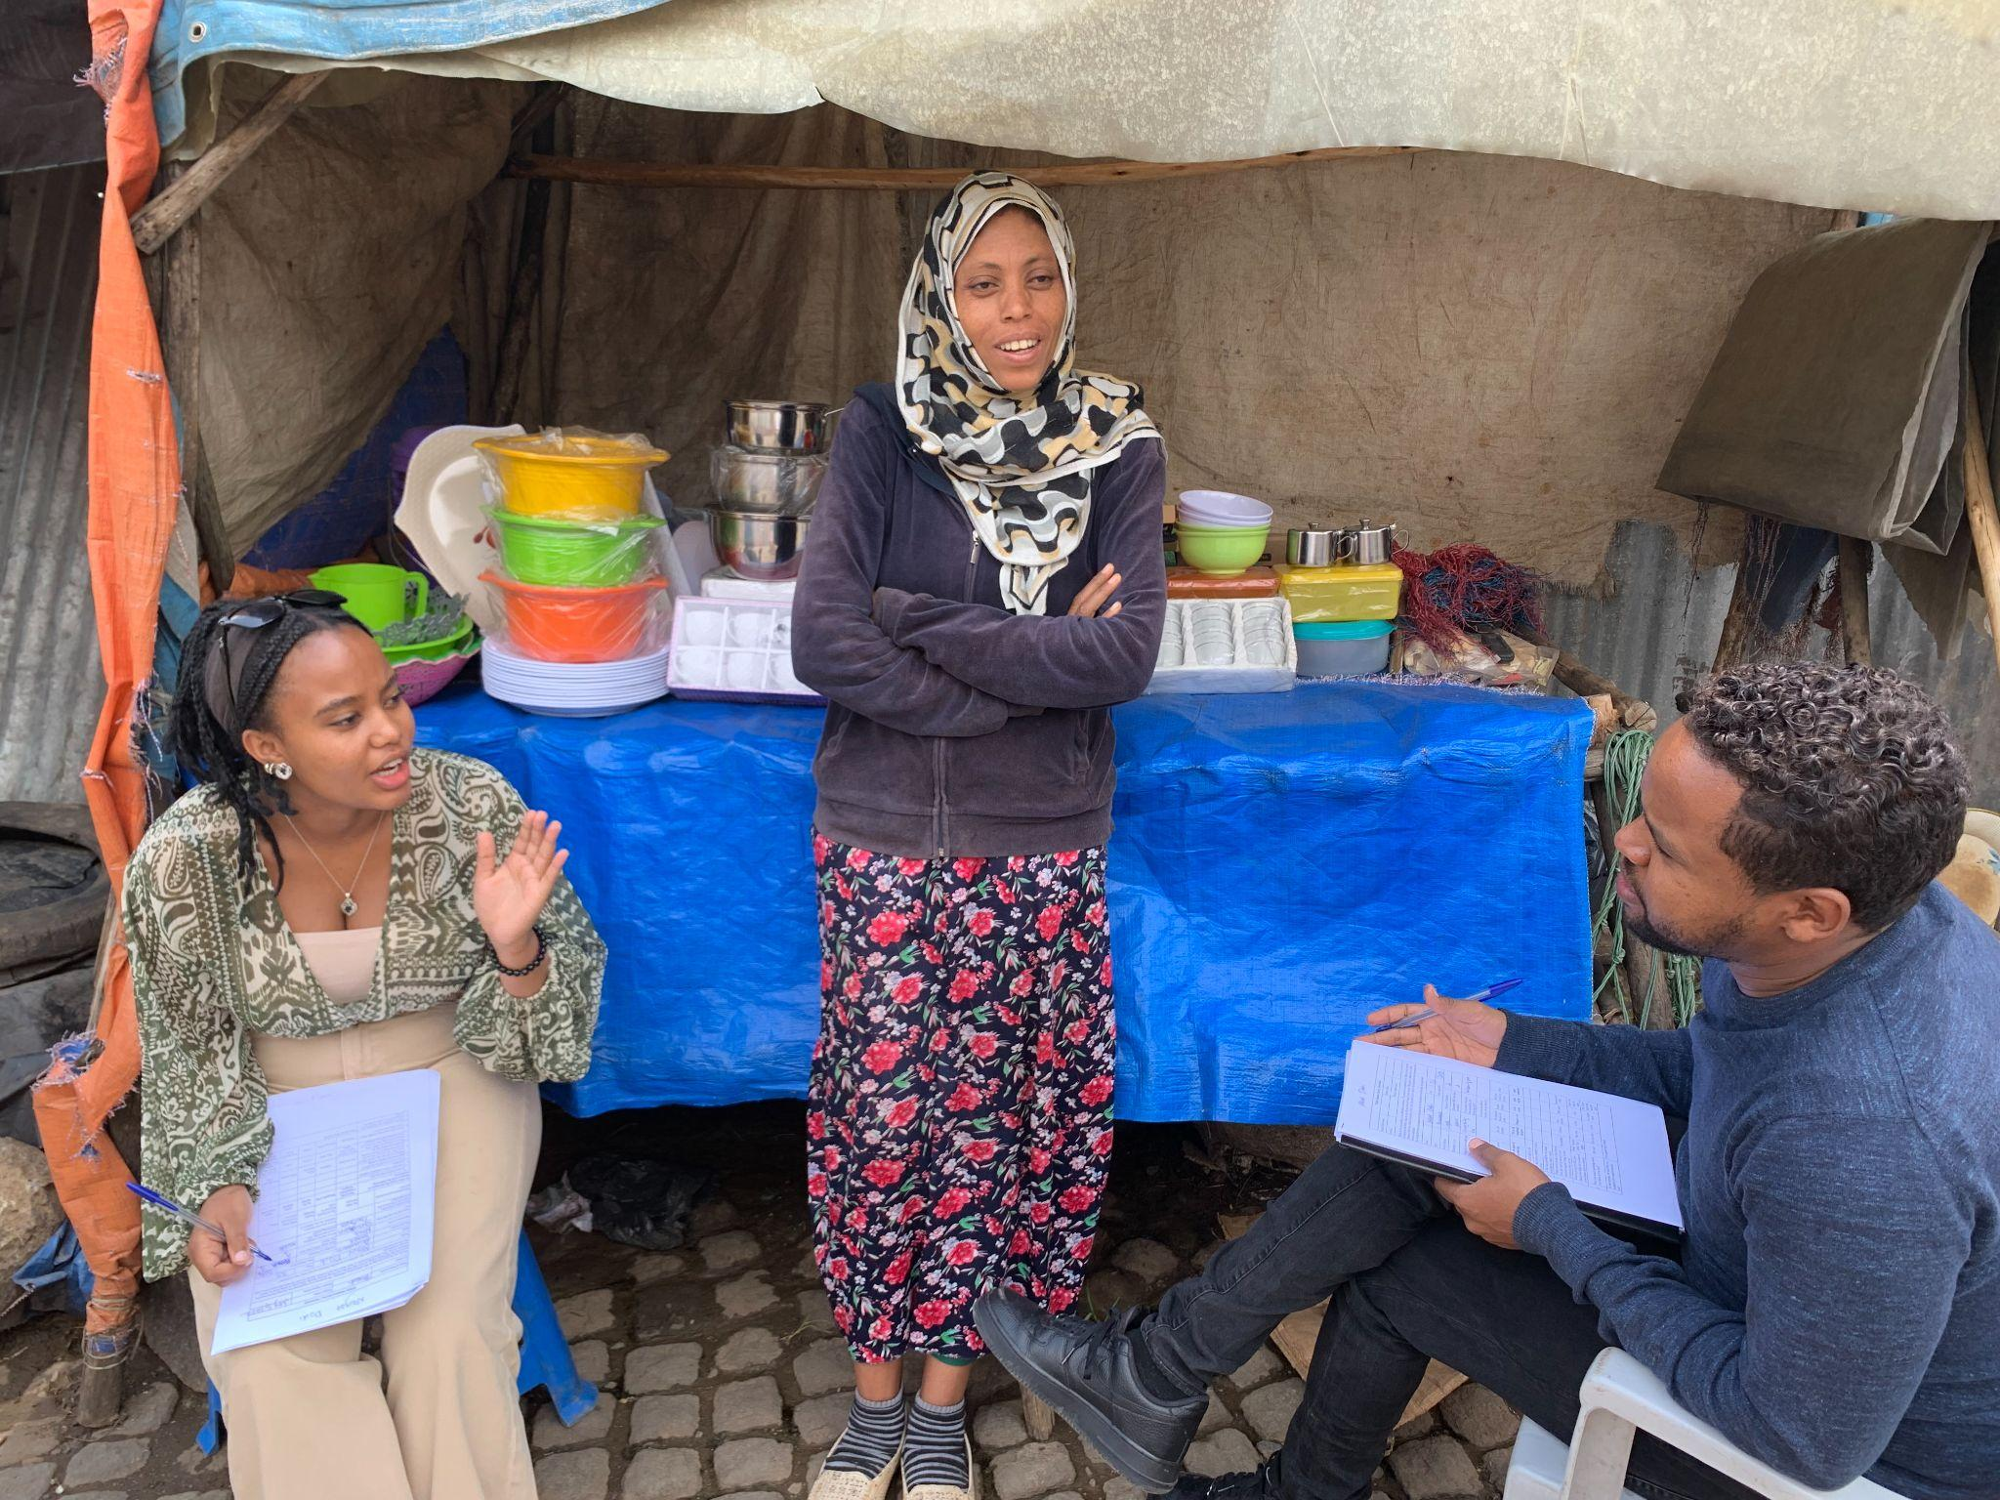
Microloans - Small business development

Slide 9
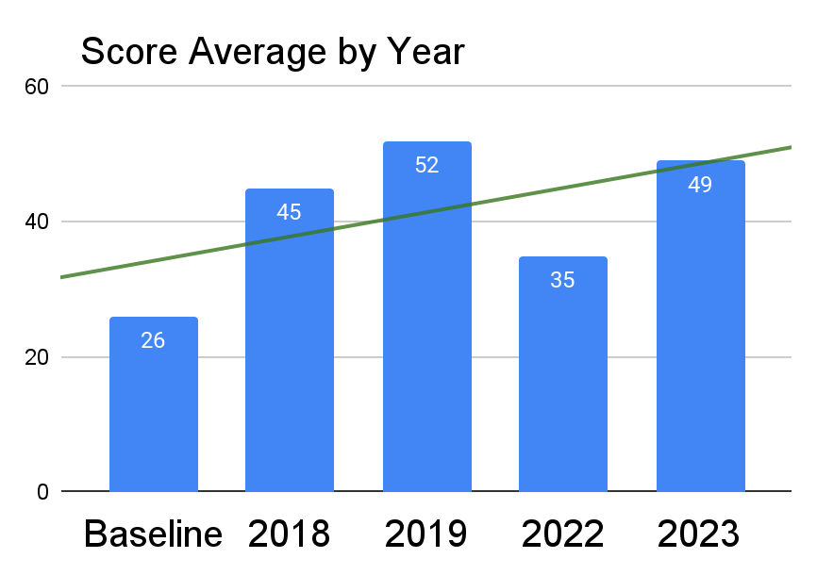
Finding: Financial gains

Slide 10
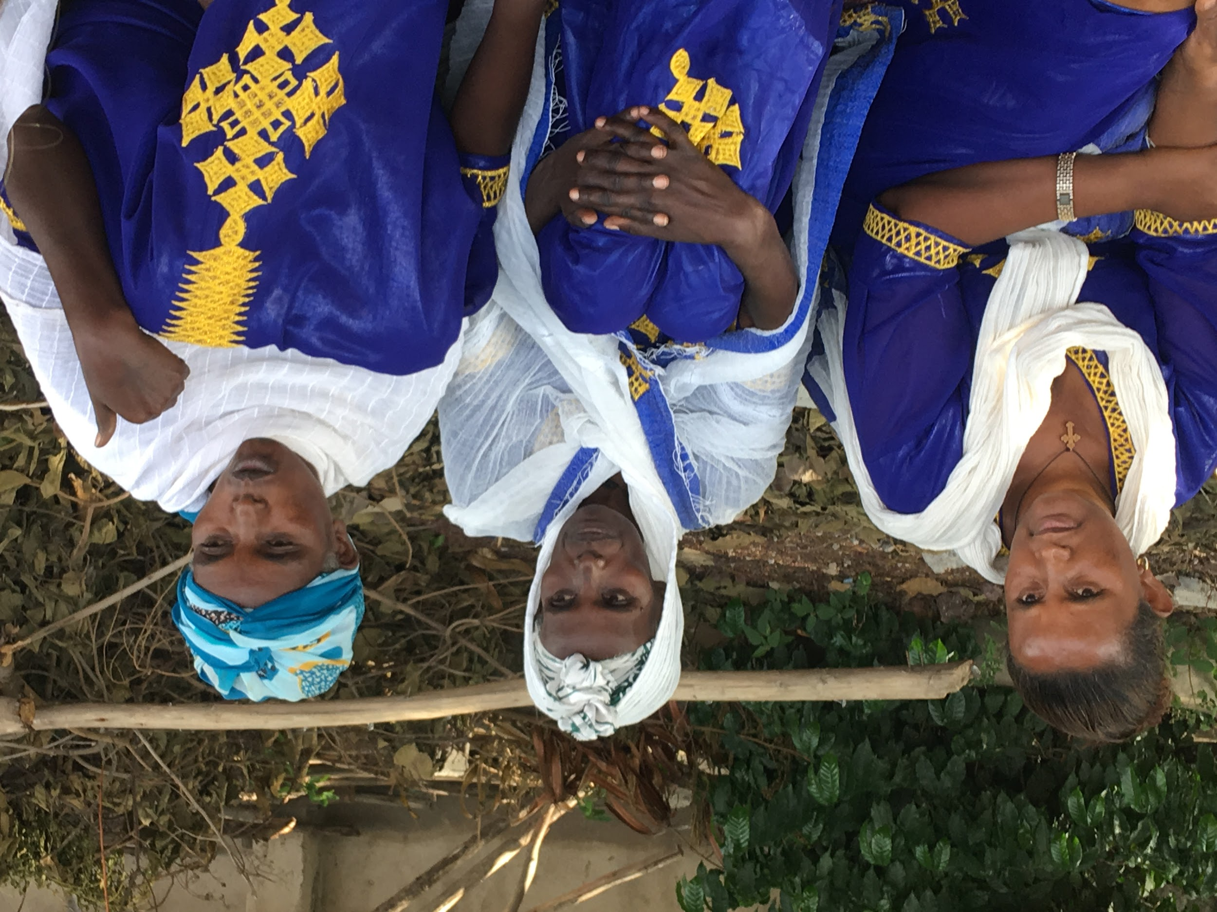
Finding: Psycho-social benefits - Social support, mental, marriage and family

Slide 11
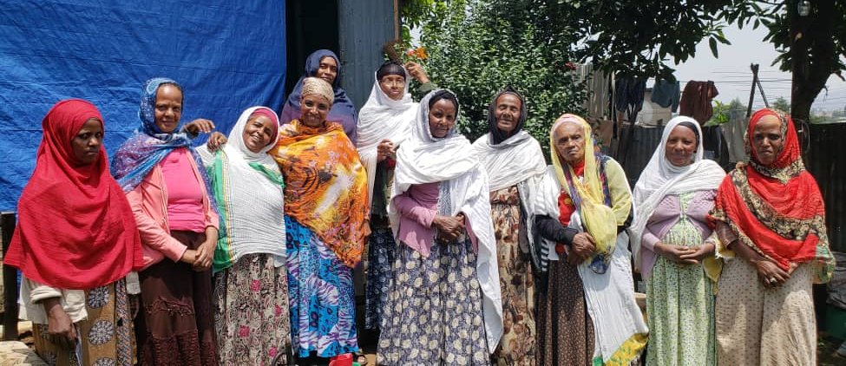
The “Self-Help Approach”
No “Hand-outs”
No money or asset transfer from donor
Other than organizing groups and conducting workshops, no additional inputs

Slide 12
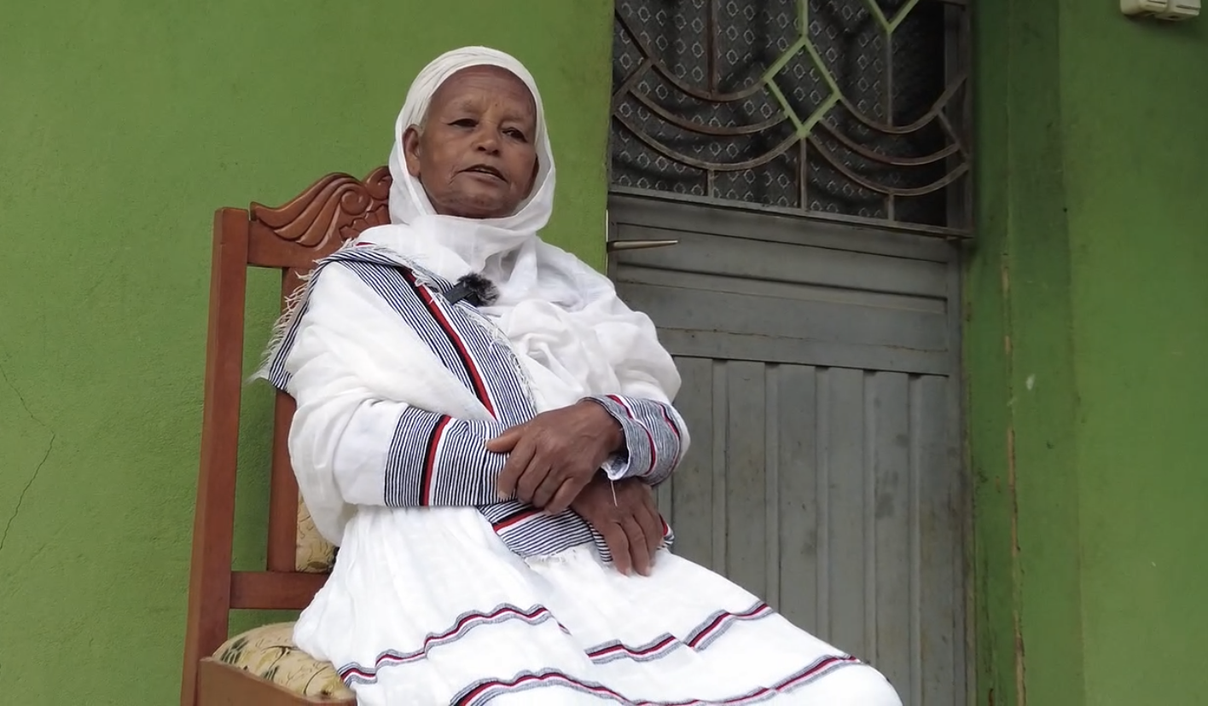
Empowerment - Psycho-social
Confidence, personal and community action

